Slide 1

HOSPITAL MANAGEMENT SYSTEM DATA MANAGEMENT AND DATABASE DESIGN(SPRING 2022)

Slide 2


The team:
SAI KRISHNA KOTLA
SARVESH SAWANT
RUCHITA YARLAGADDA
NIHAL GAJBHIYE
ZHENG ZHANG
HITECH REDDY CHERUKUPALLY

Slide 3
Problem statement
Hospitals have to usually keep track of a lot of information both GENERAL(like name address etc.,) and HEALTHCARE (like diagnostic, treatment, lab test and surgery information).
Hospitals typically maintain this data in ledgers and in form of other reports. This approach has problems of information security, lost paperwork(diagnostic, treatment and medical history etc.,) and lack of easy accessibility.
Information security is important because any General or Healthcare information lost could be easily misused by anyone and the hospital’s information security would be under question.
Lost paperwork especially medical history might create problems for the patient as patient may not accurately remember his previous medical conditions that might affect the current treatment.
Accessibility of records for all the stakeholders is difficult and we could improve on accessibility and it leads to less mistakes in the entire process as well.

Slide 4



Project vision
We have created a database for managing all the needs of a Hospital.
We started by identifying all the requirements and then creating used a Top-Down approach to create the database.
Functionality developed includes creating views, procedures, security and other constraints to develop a robust database.
The system developed could help hospitals, employees and patients with all their General and Healthcare Information needs.

Slide 5
IMPORTANT FUNCTIONALITIES OF THE DATABASE
Scheduling appointments for doctors.
Storing medical history of patients for future uses.
Views created with high safety and easier accessibility for the stakeholders involved.
The database tries to eliminate human errors in the data entered by implementing appropriate constraints.
Procedures have been created for all repetitive tasks so that the users can enter values easily.
Staff can easily find doctors and rooms that are currently available so as to schedule
Unique id’s are autogenerated for all types of id’s so that the staff doesn’t have to remember or recheck the id’s again and again.

Slide 6
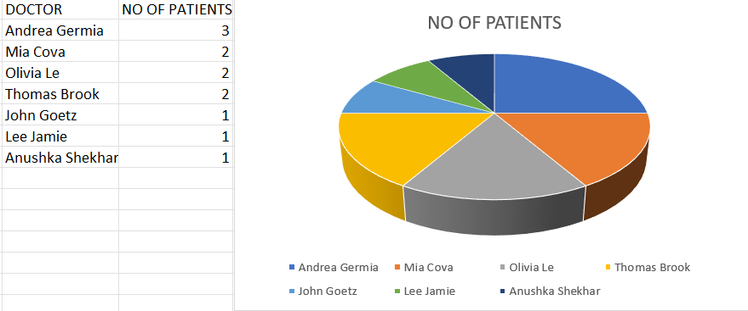
Query about doctors having the most patients

Slide 7
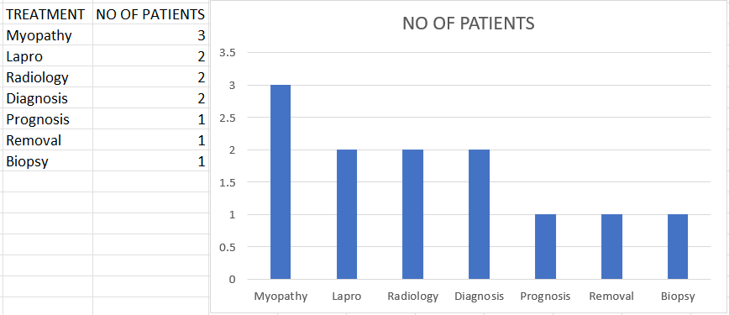
Query about most patients undergoing a treatment

Slide 8
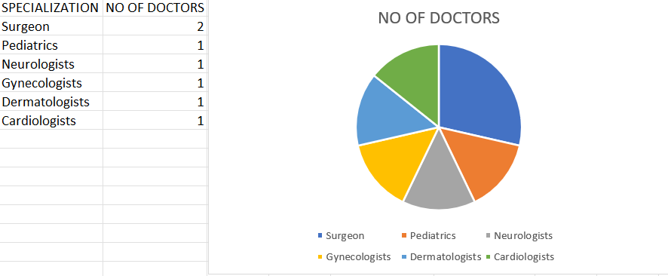
Query about the types of doctors by profession

Slide 9
Future scope
The project has a lot of scope for the future as a lot more functionalities could be added and newer versions need to be created as changes in the process, business requirements, stakeholder requirements or regulations occur.
More tables/ procedures/ constraints/triggers could be added based on the requirements of the stakeholders

Slide 10

Questions?

Slide 11

Thank you
TEAM-4

